Slide 1
Chongqing University of Technology
ATAI
Advanced Technique of Artificial Intelligence
Chongqing University of Technology
https://github.com/lvguofeng/GNN PPI
Learning Unknown from Correlations: Graph Neural Network for Inter-novel-protein Interaction Predictionfor
Guofeng Lv , Zhiqiang Hu, Yanguang Bi , Shaoting Zhang
SenseTime Research
flvguofeng, huzhiqiang, biyanguang, zhangshaotingg@sensetime.com
https://github.com/lvguofeng/GNN_PPI
IJCAI_2021
Reported by Xinsheng Wang

Slide 2
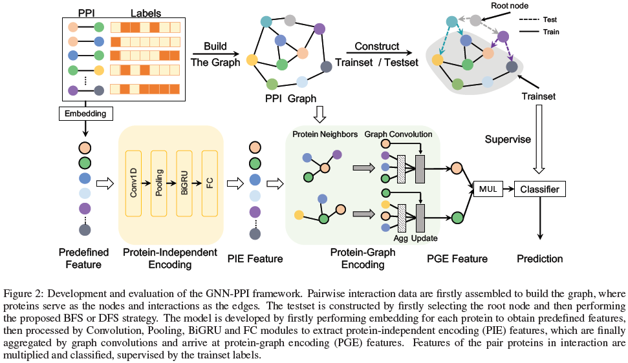
Method

Slide 3
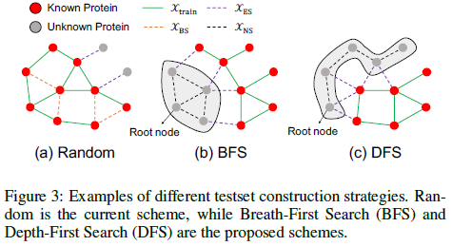
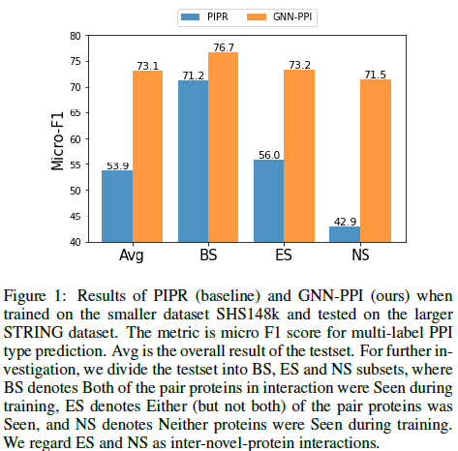
Method
Evaluation Framework
Notes:
随机选择一个节点作为根节点

Slide 4
Experiments

Slide 5
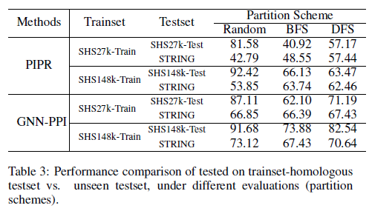
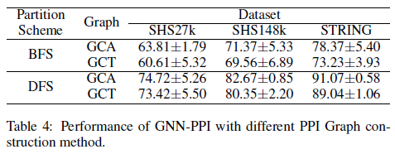
Experiments

Slide 6
Experiments

Slide 7
Experiments

Slide 8
Thank you!

